Slide 1
Dimensional Modeling

Slide 2
Data Modelling

Slide 3
Data Modelling levels
These describe how detailed your data model is, from business idea to actual tables.
🔹 Conceptual Data Model (CDM)
🔹 Logical Data Model (LDM)
🔹 Physical Data Model (PDM)

Slide 4
CDM
Business view of data
High-level
No technical details
Focuses on what data exists, not how
Characteristics
Entities
Relationships
No attributes, no data types
Example
Customer ── places ── Order ── contains ── Product
Used by: Business users, architects Answers: What data do we care about?

Slide 5
🔹 Logical Data Model (LDM)
Detailed structure, still DB-agnostic
Adds attributes
Defines primary & foreign keys
Normalized (3NF)
Characteristics
Entity attributes
Relationships
No database-specific types
Example
Customer (Customer_ID, Name, Email)
Order (Order_ID, Order_Date, Customer_ID)
Product (Product_ID, Product_Name, Price)
Used by: Data architects Answers: How is data logically structured?

Slide 6
🔹 Physical Data Model (PDM)
Implementation in a specific database
Tables, columns
Data types
Indexes, partitions
Example (MySQL)
customer_id INT PRIMARY KEY,
email VARCHAR(100),
created_at TIMESTAMP
Used by: DBAs, engineers Answers: How is data stored physically?

Slide 7
Analytics-focused modeling technique (Kimball)
Goal
Fast querying
Easy to understand
Optimized for BI
Core Components
Fact tables
Dimension tables
Used in data warehouses & lakehouses Optimized for read-heavy workloads

Slide 8
Steps to Create Dimensional Data Modeling
Step-1: Identifying the business objective: The first step is to identify the business objective. Sales, HR, Marketing, etc. are some examples of the need of the organization. Since it is the most important step of Data Modelling the selection of business objectives also depends on the quality of data available for that process.
Step-2: Identifying Granularity: Granularity is the lowest level of information stored in the table. The level of detail for business problems and its solution is described by Grain.
Step-3: Identifying Dimensions and their Attributes: Dimensions are objects or things. Dimensions categorize and describe data warehouse facts and measures in a way that supports meaningful answers to business questions. A data warehouse organizes descriptive attributes as columns in dimension tables. For Example, the data dimension may contain data like a year, month, and weekday.
Step-4: Identifying the Fact: The measurable data is held by the fact table. Most of the fact table rows are numerical values like price or cost per unit, etc.
Step-5: Building of Schema: We implement the Dimension Model in this step. A schema is a database structure. There are two popular schemes: Star Schema and Snowflake Schema.

Slide 9
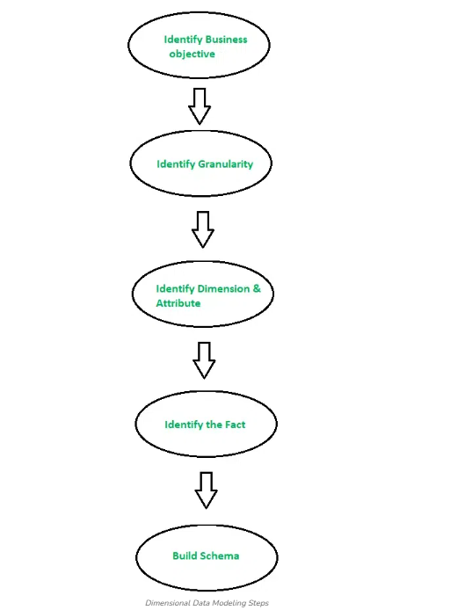

Slide 10
Dimensional Data Modelling Approaches
Star Schema
Snowflake Schema ❄️

Slide 11
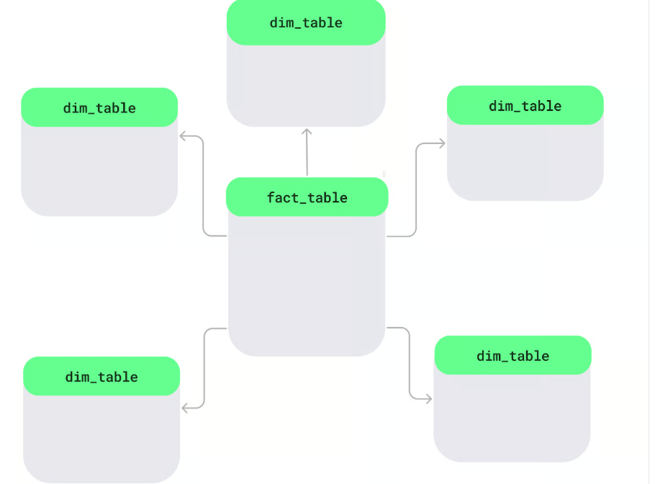
What is a Star Schema?
A star schema is a way to organize data in a database, especially in data warehouses, to make it easier and faster to analyze.
At the center, there's a main table called the fact table, which holds measurable data like sales or revenue.
Around it are dimension tables, which add details like product names, customer info, or dates.
This layout forms a star-like shape.

Slide 12
key features of the star schema
Single-level dimension tables: The dimension tables connect directly to the fact table without extra layers. Each table focuses on one area, like products, regions, or time, making it simple to use.
Denormalized design: In a star schema, related data is stored together in one table using a denormalized approach. For example, a product table may include the product ID, name, and category in the same place. While this may mean some data repetition, it processes queries faster.
Common in data warehousing: The star schema is used for quick analysis. It can easily filter or calculate totals, so it’s likely a good choice for data warehouses where fast insights are required.

Slide 13
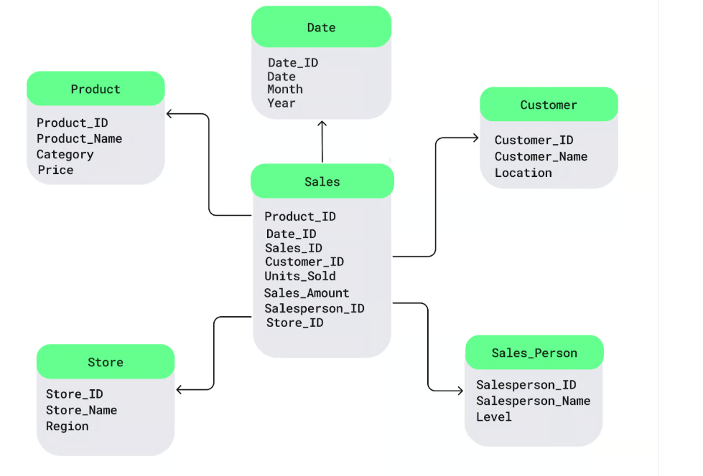
Star Schema Design Example

Slide 14
SQL example for setting up a star schema with a Sales fact table and dimension tables for Product, Customer, and Date:
-- Fact table
CREATE TABLE Sales (
Sales_ID INT PRIMARY KEY,
Product_ID INT,
Customer_ID INT,
Date_ID INT,
Sales_Amount DECIMAL(10, 2),
FOREIGN KEY (Product_ID) REFERENCES Product(Product_ID),
FOREIGN KEY (Customer_ID) REFERENCES Customer(Customer_ID),
FOREIGN KEY (Date_ID) REFERENCES Date(Date_ID)
);

Slide 15
-- Dimension table: Product
CREATE TABLE Product (
Product_ID INT PRIMARY KEY,
Product_Name VARCHAR(100),
Category VARCHAR(50)
);
-- Dimension table: Customer
CREATE TABLE Customer (
Customer_ID INT PRIMARY KEY,
Customer_Name VARCHAR(100),
Location VARCHAR(50)
);
-- Dimension table: Date
CREATE TABLE Date (
Date_ID INT PRIMARY KEY,
Date DATE,
Year INT,
Month VARCHAR(20)
);

Slide 16
To retrieve total sales grouped by customer location.
SELECT c.Location, SUM(s.Sales_Amount) AS TotalSales
FROM Sales s
JOIN Customer c ON s.Customer_ID = c.Customer_ID
GROUP BY c.Location;

Slide 17
Characteristics
Denormalized dimensions
Simple joins
Excellent performance

Slide 18
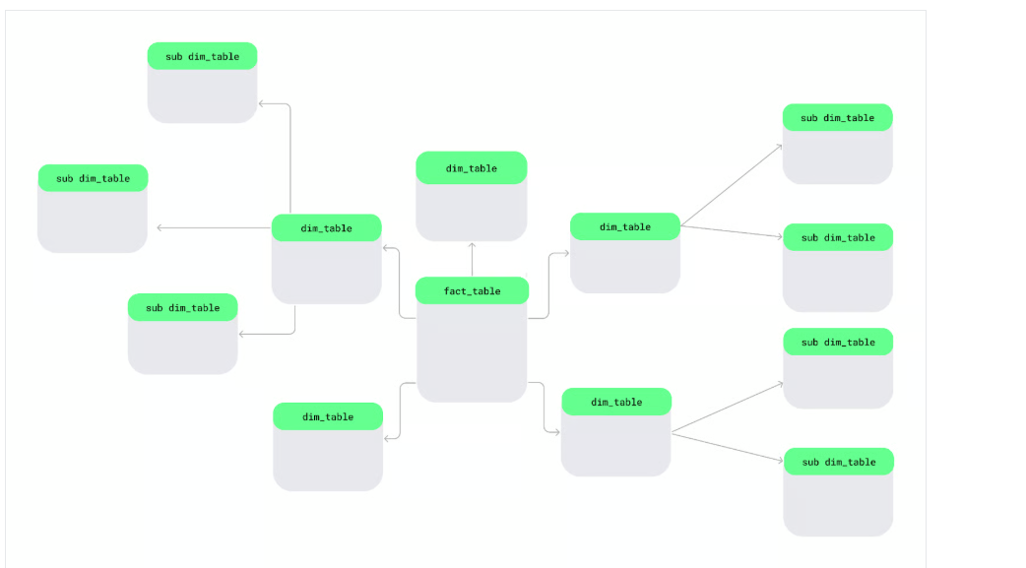
What is a Snowflake Schema?
A snowflake schema is another way of organizing data. In this schema, dimension tables are split into smaller sub-dimensions to keep data more organized and detailed — just like snowflakes in a large lake.

Slide 19
Multi-level dimension tables: We can break down our dimension tables into smaller, more specific tables. For example, if I want to track store locations, instead of putting all location details in one big table, I can split them into separate tables for countries, states, and cities. This way, each table would contain only the information it needs to reduce redundancy and improve organization.
Normalization for storage efficiency: Unlike star schema, the snowflake schema follows a normalized design, which avoids data duplication. For example, rather than repeating a product category like Electronics for every product, I can store the category in a separate table and link it to individual products.
Suitability for complex data environments: The snowflake schema works best for complex data environments because it uses multi-level tables to handle intricate relationships and hierarchical data structures.

Slide 20
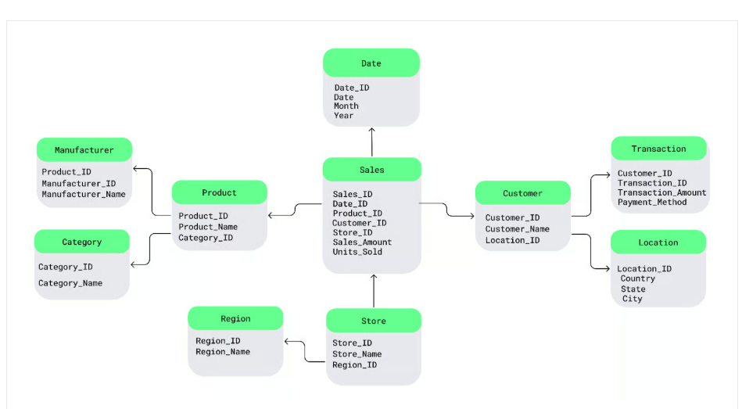

Slide 21
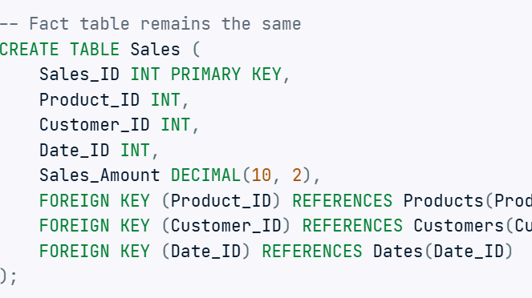

Slide 22
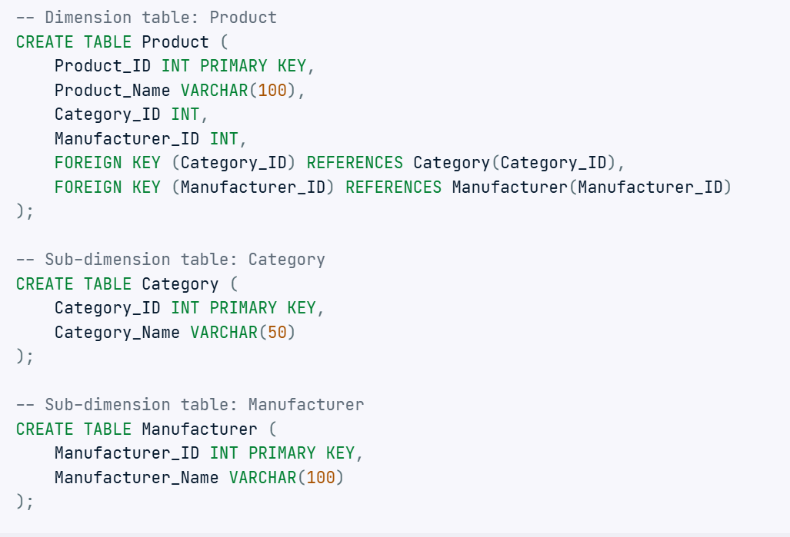

Slide 23
SELECT cat.Category_Name, SUM(s.Sales_Amount) AS TotalSales
FROM Sales s
JOIN Product p
ON s.Product_ID = p.Product_ID
JOIN Category cat
ON p.Category_ID = cat.Category_ID
GROUP BY cat.Category_Name;

Slide 24
Characteristics
More joins
Less redundancy
More complex queries
📌 Pros: Storage efficient 📌 Cons: Slower queries 📌 Used when dimensions are very large or hierarchical

Slide 25
Feature | Star Schema | Snowflake Schema
Complexity | Simple | Complex
Joins | Fewer | More
Performance | Faster | Slower
Storage | More | Less
BI Friendly | ✅ Yes | ❌ Less

